Slide 1
Introduction to Neural Networks with Keras
Steven L. Shafer, MD Professor Emeritus of Anesthesiology, Perioperative and Pain Medicine,
Stanford University

Slide 2
Conflicts-of-Interest
None

Slide 3






Slide 4
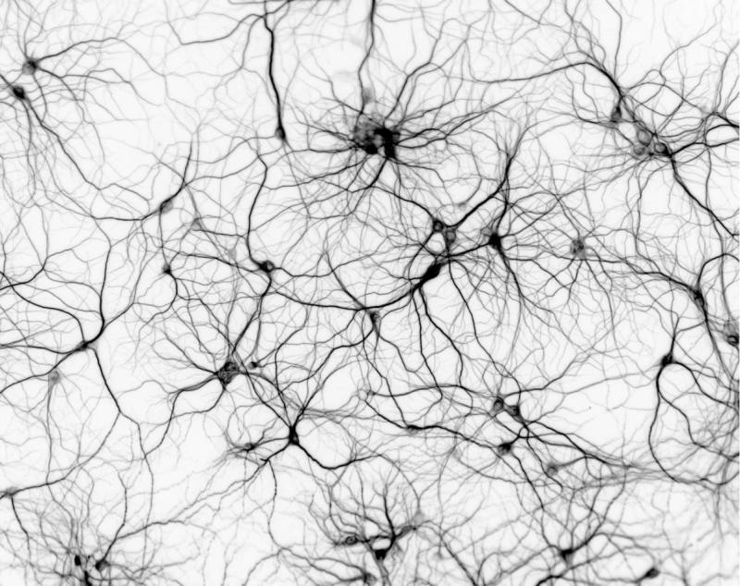

Slide 5
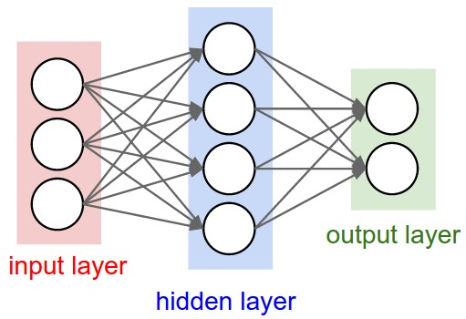

Slide 6
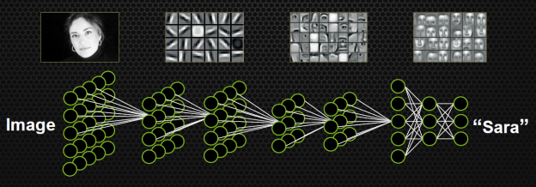

Slide 7

The purpose of Keras is to give an unfair advantage to any developer looking to ship Machine Learning-powered apps.
Keras focuses on debugging speed, code elegance & conciseness, maintainability, and deployability.
When you choose Keras, your codebase is smaller, more readable, easier to iterate on. Your models run faster thanks to XLA compilation with JAX and TensorFlow

Slide 8
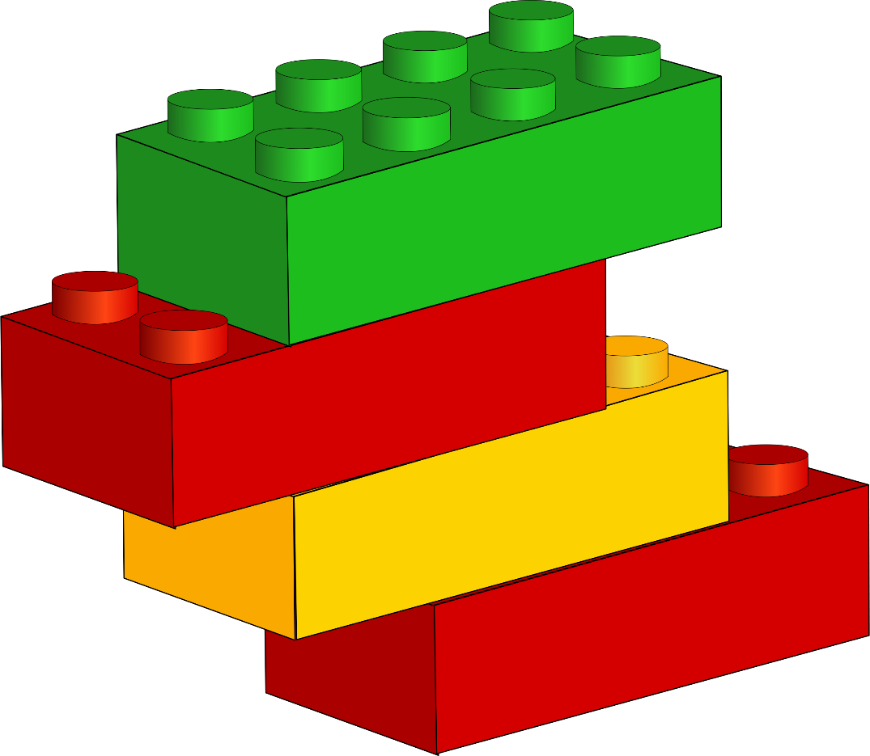

Slide 9
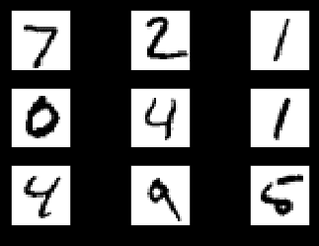
MNIST EXAMPLE
National Institute of Standards and Technology
60,000 handwritten digits, 0-9

Slide 10
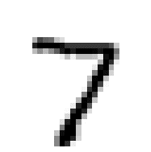
Convolution Neural Network
28 pixels
28 pixels

Slide 11
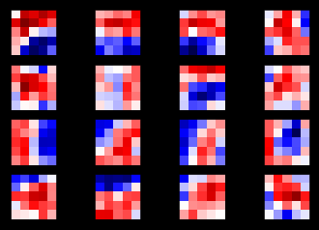
Convolution Neural Network
28 pixels
5 pixels
5 pixels
28 pixels

Slide 12
Convolution Neural Network

Slide 13
Convolution Neural Network

Slide 14
Convolution Neural Network

Slide 15
Convolution Neural Network

Slide 16
Convolution Neural Network

Slide 17
Convolution Neural Network

Slide 18
Convolution Neural Network

Slide 19
Convolution Neural Network

Slide 20
Convolution Neural Network

Slide 21
Convolution Neural Network

Slide 22
Convolution Neural Network

Slide 23
Convolution Neural Network

Slide 24
Convolution Neural Network

Slide 25
Convolution Neural Network

Slide 26
Convolution Neural Network

Slide 27
Convolution Neural Network

Slide 28
Convolution Neural Network

Slide 29
Convolution Neural Network

Slide 30
Convolution Neural Network

Slide 31
Convolution Neural Network

Slide 32
Convolution Neural Network

Slide 33
Convolution Neural Network

Slide 34
Convolution Neural Network

Slide 35
Convolution Neural Network

Slide 36
Convolution Neural Network

Slide 37
Convolution Neural Network

Slide 38
Convolution Neural Network

Slide 39
Convolution Neural Network

Slide 40
Convolution Neural Network

Slide 41
Convolution Neural Network

Slide 42
Convolution Neural Network

Slide 43
Convolution Neural Network

Slide 44
Convolution Neural Network

Slide 45
Convolution Neural Network

Slide 46
Convolution Neural Network

Slide 47
Convolution Neural Network

Slide 48
First Convolution Layer: 1 input → 16 outputs

Slide 49
First Convolution Layer: 1 input → 16 outputs
16 kernels x 25 weights/kernel = 400 weights

Slide 50
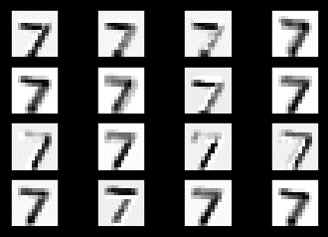
First Convolution Layer: 1 input → 16 outputs

Slide 51

# First convolution layer
first_layer = new_conv_layer(
input=image,
num_input_channels=1,
kernel_size=5,
num_kernels=16)

Slide 52
Second Convolution Layer
16 14x14 images

Slide 53
Second Convolution Layer
16 14x14 images

Slide 54
Second Convolution Layer
5x5 kernel
16 14x14 images

Slide 55
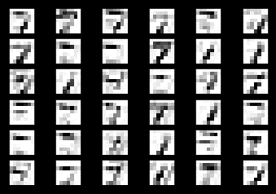
Second Convolution Layer
5x5 kernel
16 14x14 images

Slide 56
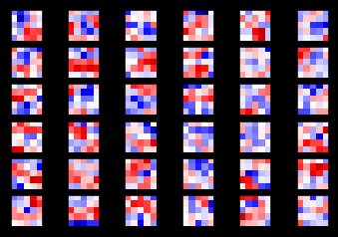
Second Convolution Layer: 36 kernels
25 weights/kernel * 36 kernels = 900 weights

Slide 57
Second Convolution Layer
36 kernals → 36 images

Slide 58
Second Convolution Layer has 16 images
16 14x14 images

Slide 59
Second Convolution Layer
16 images in the input layer
900 weights/image x 16 images = 14400 weights

Slide 60
Second Convolution Layer 16 inputs → 576 outputs
16 14x14 images
16 images x 36 kernels/image = 576 7x7 images

Slide 61
# Second convolution layer
second_layer = new_conv_layer(
input=first_layer,
num_input_channels=16,
kernel_size=5,
num_kernels=36)
16 input images x 36 kernels = 576 output images

Slide 62
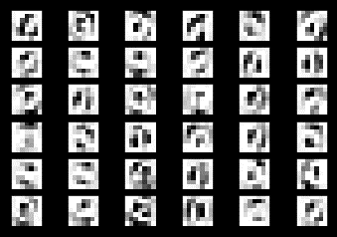
Third Step – Flatten
576 7x7 images
0 new weights

Slide 63
Third Step – Flatten 576 inputs → 36 outputs

Slide 64
# Third step – flatten
third_layer = flatten_layer(second_layer)
36 7x7 images = 1764 “features”
576 7x7 images

Slide 65
Fourth step: Fully Connected Layer
128 Cells
36 7X7 images
(1764 pixels)

Slide 66
Fourth step: Fully Connected Layer
128 Cells
36 7X7 images
(1764 pixels)

Slide 67
Fourth step: Fully Connected Layer
128 Cells
36 7x7 images
(1764 pixels)
7x7x36x128=225792 weights

Slide 68
# Fourth layer - the fully connected layef
fourth_layer = new_fc_layer(
input=third_layer,
num_inputs=1764,
num_outputs=128)

Slide 69

Final Fully Connected Layer
128 Cells

Slide 70
Final Fully Connected Layer 128 inputs → 10 outputs
128 Cells
1280 weights

Slide 71
# Fifth layer – final fully connected layer
fifth_layer = new_fc_layer(
input=fourth_layer,
num_inputs=128
num_outputs=10)

Slide 72
# Fifth layer – final fully connected layer
fifth_layer = new_fc_layer(
input=fourth_layer,
num_inputs=12,
num_outputs=10)

Slide 73
Lego Blocks of a Convolution Neural Network
First Convolution Layer
1 input → 16 outputs, 400 weights
Second Convolution Layer
16 inputs → 576 outputs, 14400 weights
Flatten Layer
576 inputs → 36 outputs, 0 weights
Fully Connected Layer
36 inputs → 128 outputs, 225792 weights
Final Layer
128 outputs → 10 outputs, 1280 weights

Slide 74
Lego Blocks of a Convolution Neural Network
Overall structure
1 input → 10 outputs
241,872 weights
The steps were shown for image 1.
The steps run in parallel for all 60,000 images.
The 241,872 weights in the model are optimized for recognition of the entire data set.

Slide 75
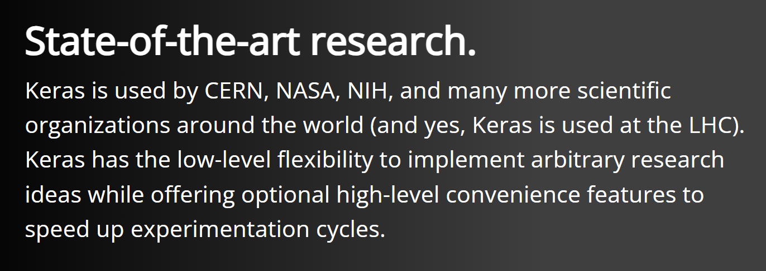

Slide 76


Slide 77
https://keras.io

